Slide 1
furniture Sales Dashboard

Slide 2
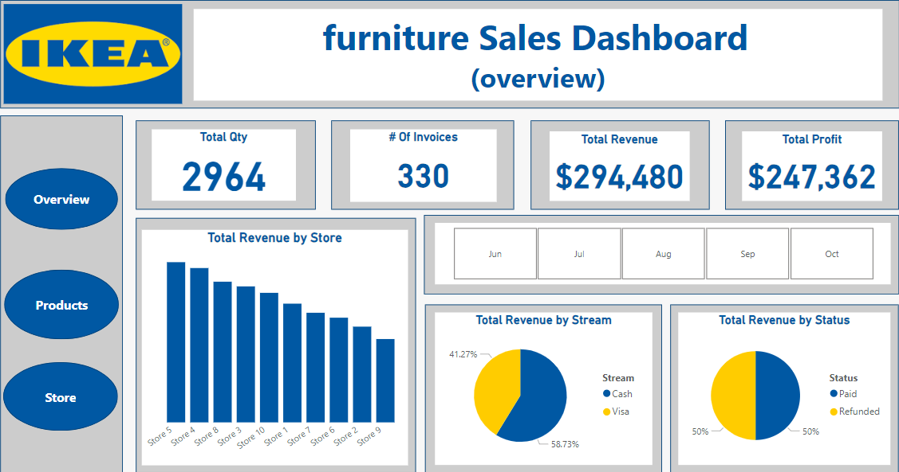
Key Metrics Overview
Total Quantity Sold: 2,964.
Number of Invoices: 330
Total Revenue: $294,480.
Total Profit: $247,362

Slide 3
Revenue Trends by Store
Store 5 is the top-performing store, generating the highest revenue.
Stores 9 and 7 are among the lowest-performing, indicating potential areas for improvement.
58.73% of revenue comes from Visa payments, while 41.27% comes from cash.
This insight indicates a preference for digital payment methods among customers,
which may guide future investments in payment infrastructure.
Paid Revenue and Refunded Revenue are balanced at 50% each.

Slide 4
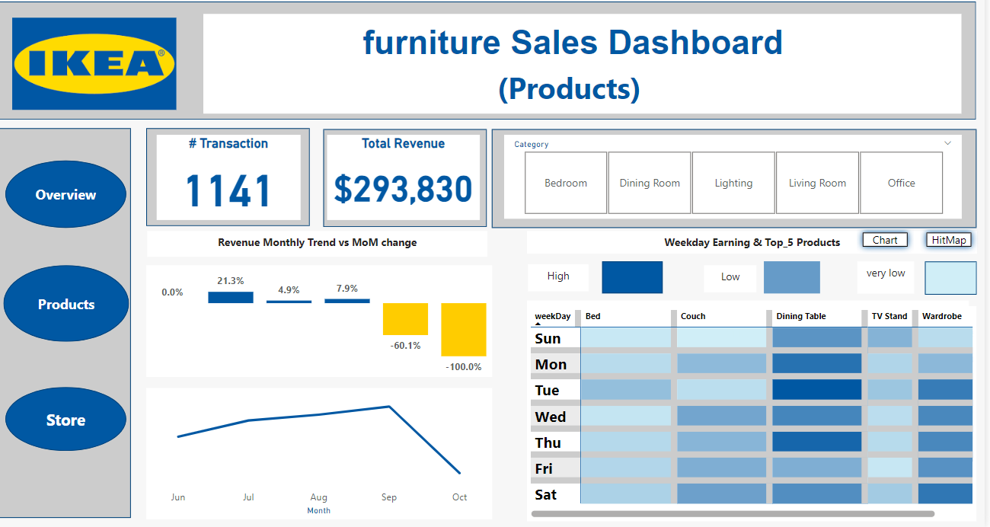
Products
# Transaction (1141): The total number of transactions recorded.Total Revenue ($293,830): The total revenue generated from sales.
21.3% growth in one month, followed by a sharp decline (-60.1% and -100%).This helps identify periods of growth and decline in revenue.

Slide 5
percentage change in revenue
Month-over-Month
MoM change = DIVIDE([Total Revenue]-[Previous Month Revenue],[Previous Month Revenue],0)
Previous Month Revenue = CALCULATE([Total Revenue],DATEADD(DateTable[Date],-1,MONTH))

Slide 6
Key Components
CALCULATE()
Purpose: Modifies a calculation by applying specific filters.
In this case, it computes the [Total Revenue] but adjusts the filter context to look at the previous month's data.
DATEADD:
Adjusts dates by a specified interval.
- Syntax: DATEADD(<Dates>, <Interval>, <TimeUnit>).
- Parameters:
DateTable[Date]: Refers to the date column in your date table.
-1: Moves the date back by 1 unit.
MONTH: Specifies that the unit of adjustment is months.

Slide 7
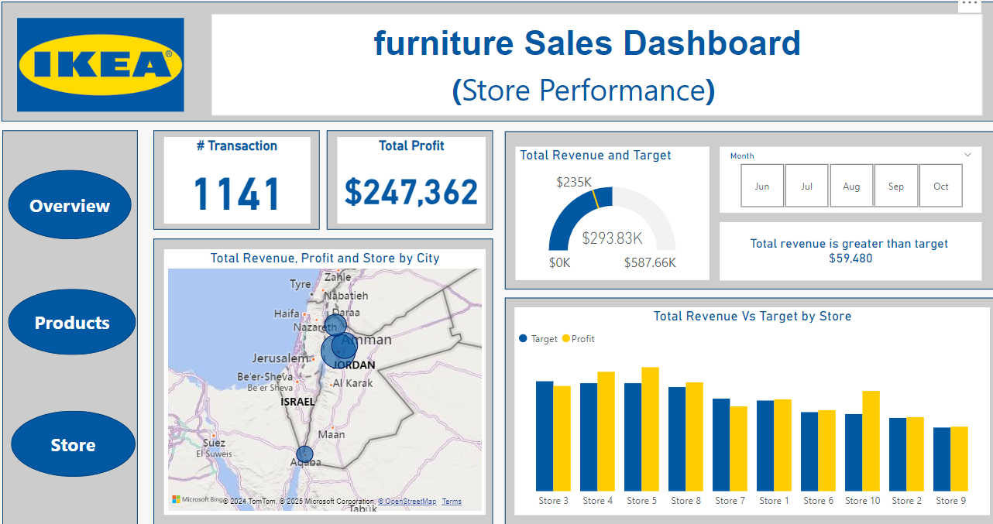
Store
Total Revenue vs Target
- Store 5 outperforms its target, while Store 6 is closer to meeting it but falls short.
Total revenue is greater than target by $59,480" highlights that revenue has exceeded the set goal, which is a positive outcome.

Slide 8
Gauge Caption
Gauge Caption =
VAR varaince_Goal=[Total Revenue]-[Total Target]
VAR Month_select=SELECTEDVALUE('DateTable'[Month])
RETURN
IF ( varaince_Goal>1,"Total revenue is greater than target "&"
"&FORMAT(varaince_Goal,"$#,##"),"You coud not met your target in
"&Month_select& ". "&FORMAT(varaince_Goal,"$#,##") &" lower than target")

Slide 9
The formula starts by defining two variables:
1. Declaring Variables
a. variance_Goal
b. Month_select
VAR variance_Goal = [Total Revenue] - [Total Target]
VAR Month_select = SELECTEDVALUE('DateTable'[Month])

Slide 10
2. Return Statement
The RETURN section generates the actual text caption based on whether the revenue meets or exceeds the target. The logic is implemented using an IF statement.
Conditional Logic
Condition: Checks if variance_Goal (difference between revenue and target) is greater than1.
Outcome: If variance_Goal > 1, it means the revenue exceeded the target
b. If the Condition is True
IF ( variance_Goal > 1,
"Total revenue is greater than target " & "
" & FORMAT(variance_Goal, "$#,##")

Slide 11
Message:
- States that total revenue exceeded the target.
- Appends the exact amount of the surplus, formatted as currency using FORMAT(variance_Goal, "$#,##").
c. If the Condition is False
Message:
- States that the target was not met.Specifies the selected month using Month_select.
- Appends the exact shortfall amount, formatted as currency using FORMAT(variance_Goal, "$#,##")
"You could not meet your target in " & Month_select & ". " & FORMAT(variance_Goal, "$#,##") & " lower than target"

